Slide 1
Machine Learning Model for Medical Image Segmentation
Nilesh
Ashish kumar

Slide 2
Agenda
Introduction
Software used
Result
conclusion

Slide 3
Introduction
Many diagnostic applications critically depend on the successful
localization of bone structure.
In this project, we have trained a machine learning model (a convolutional neural network called U-Net) to perform bone segmentation on 3D knee magnetic resonance imaging (MRI).
The goal is to develop a method that can
automatically detect the bone area from a knee MRI image.

Slide 4
In deep learning, a convolutional neural network (CNN, or ConvNet) is a class of deep neural networks, most commonly applied to analyzing visual imagery.

Slide 5
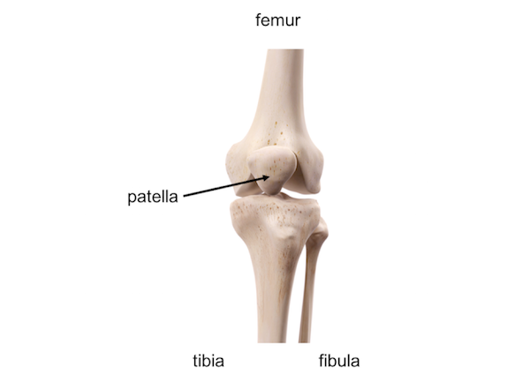
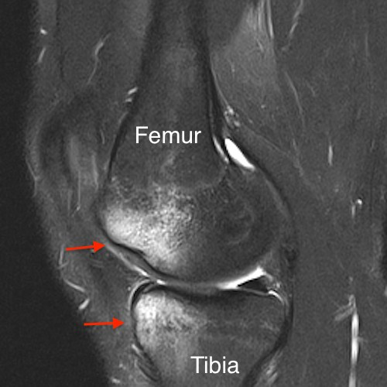

Slide 6
Software
Matlab by MathWorks
Google Colab

Slide 7
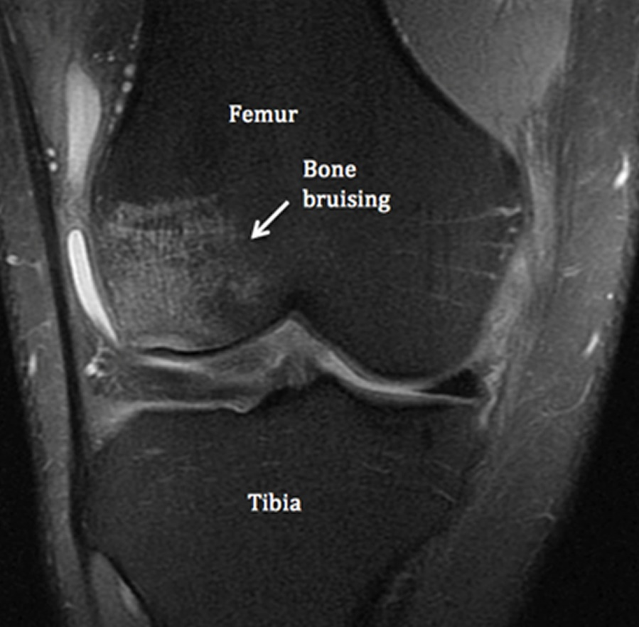

Slide 8
Dataset
45 cases of 3D knee Magnetic resonance images (MRI).
Each case with 160 images.

Slide 9
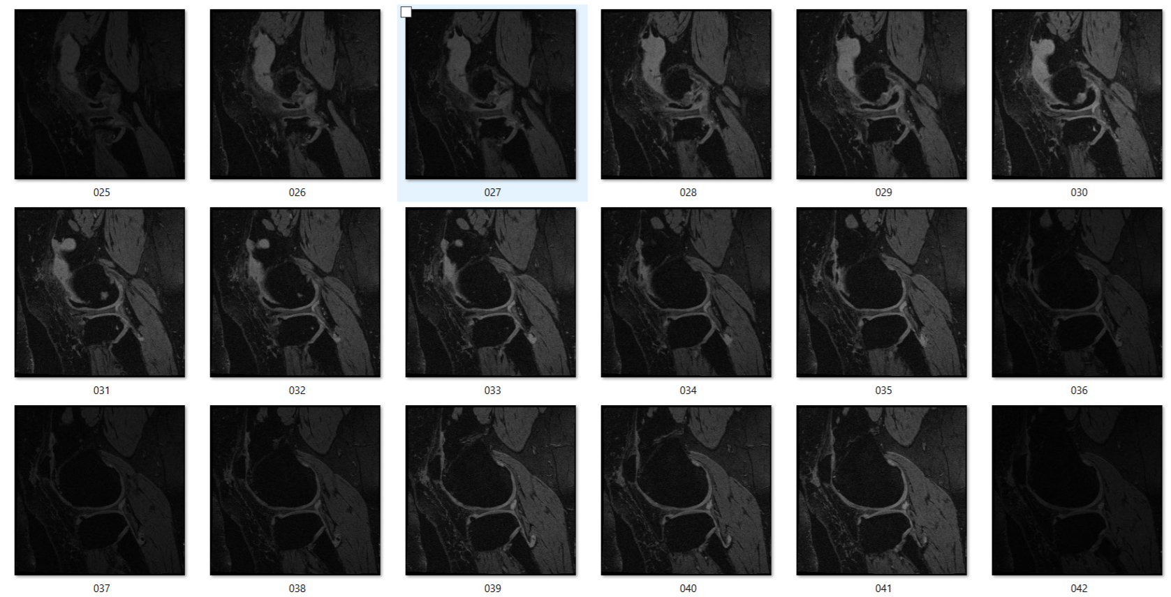
Data

Slide 10
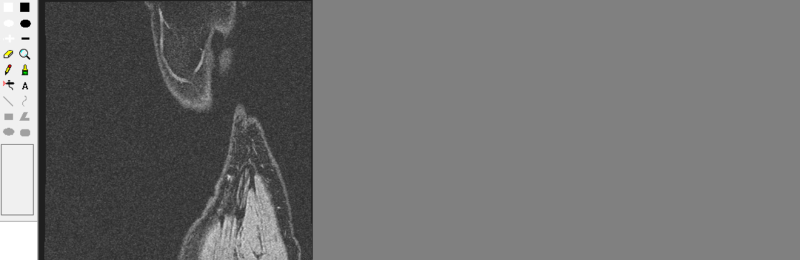
Data label

Slide 11
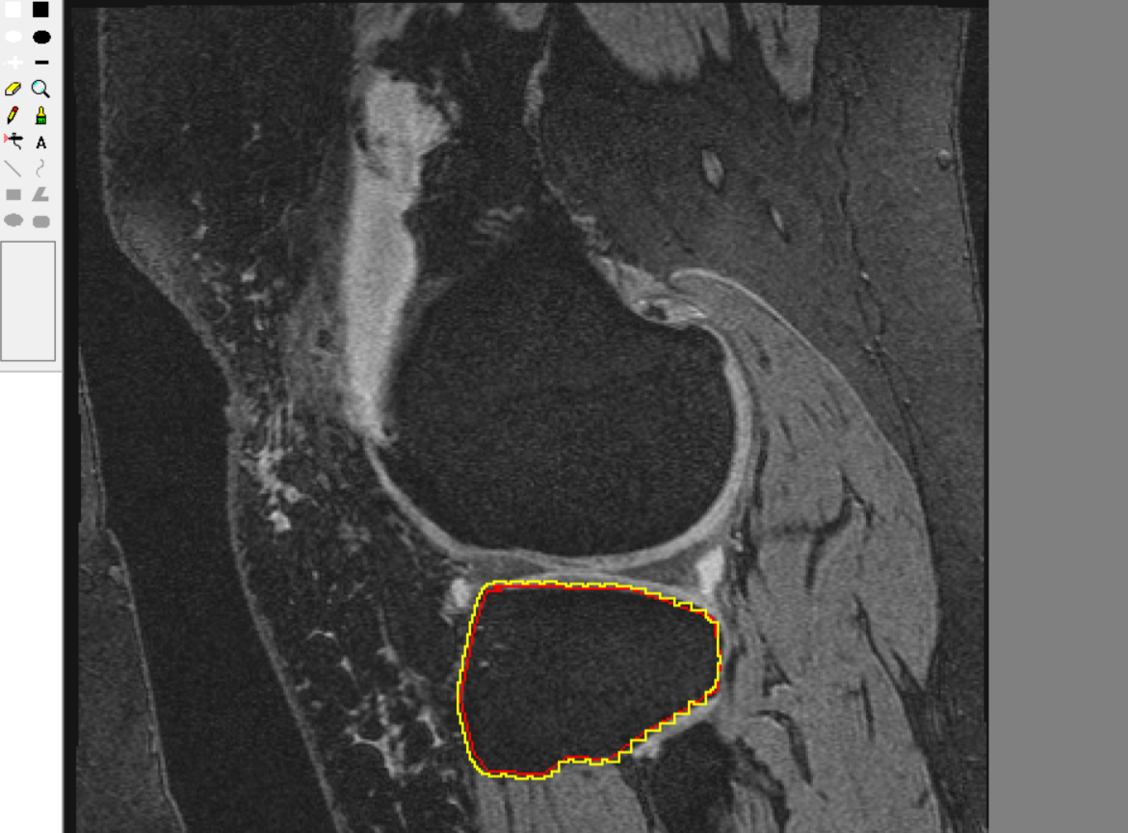

Slide 12
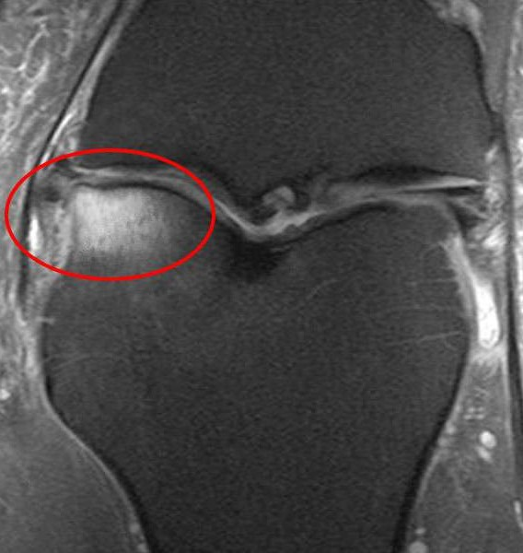

Slide 13
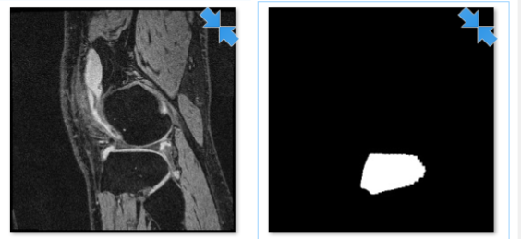
Data preparation

Slide 14
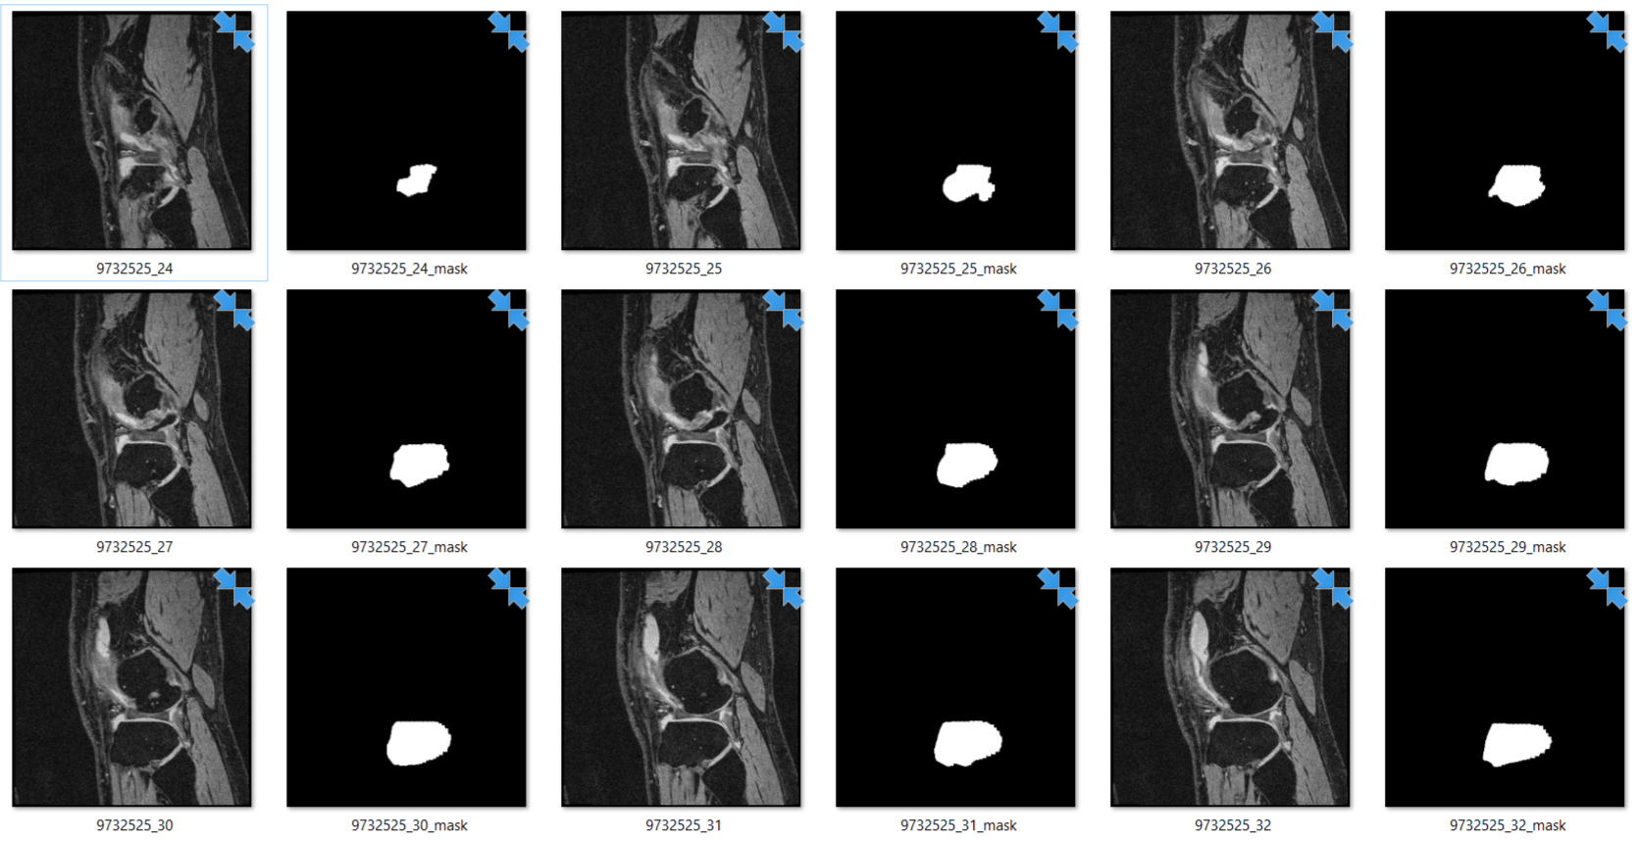

Slide 15
U-net
The U-Net is a convolutional neural network that was developed for biomedical image segmentation at the Computer Science Department of the University of Freiburg, Germany.
The network is based on the fully convolutional network and its architecture was modified and extended to work with fewer training images and to yield more precise segmentations.
Segmentation of a 512*512 image takes less than a second on a recent GPU.

Slide 16
Keras
Keras is an open-source neural-network library written in Python. It is capable of running on top of TensorFlow, Microsoft Cognitive Toolkit, Theano, or PlaidML.
Designed to enable fast experimentation with deep neural networks, it focuses on being user-friendly, modular, and extensible.
It was developed as part of the research effort of project ONEIROS (Open-ended Neuro-Electronic Intelligent Robot Operating System), and its primary author and maintainer is François Chollet, a Google engineer. Chollet also is the author of the XCeption deep neural network model.

Slide 17
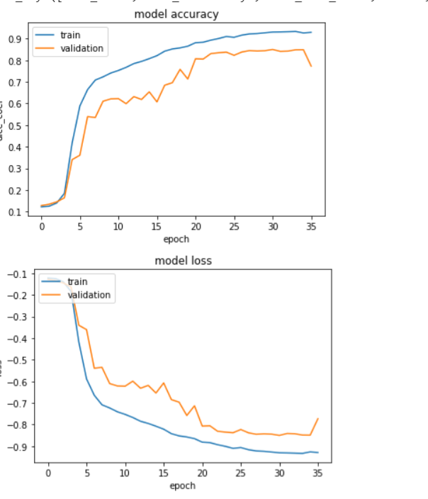
Result for 10 cases
Training : 95%
Validation:79%

Slide 18
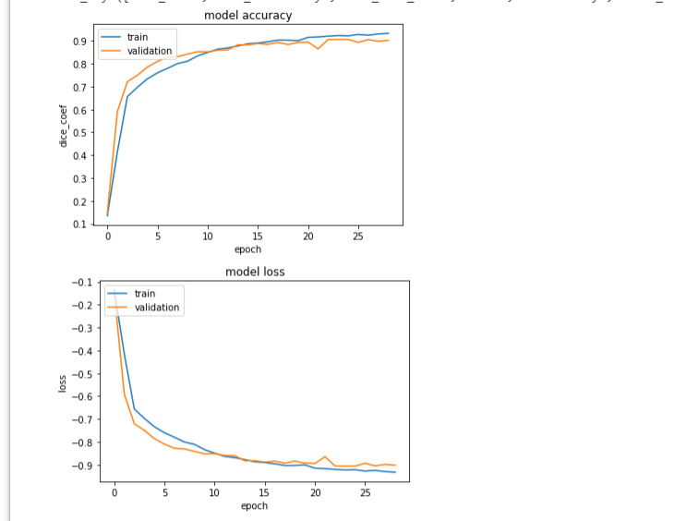
Result for 44 cases
Training : 95%
Validation:90%

Slide 19
Testing Result for 44 cases
loss: -0.883741628671
dice_coef: 0.88374163
similarity: 0.796089350
Testing Result for 10 cases
loss: -0.843198874540
dice_coef: 0.84319887
similarity: 0.73344115939

Slide 20
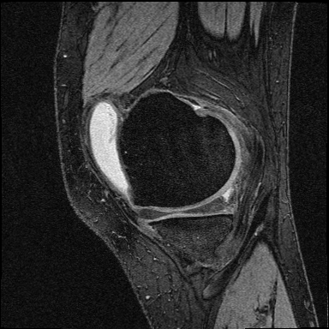
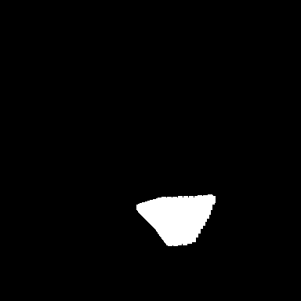
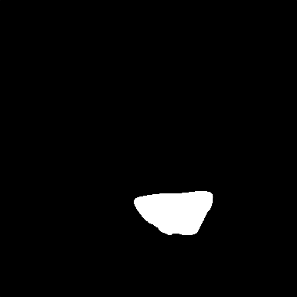
Data
Manual Segmentation
U-net Segmentation

Slide 21
Conclusion
By comparing result we can conclude that having more cases we can train model more accurately.

